Slide 1


Human Development Across the Lifespan
Development spans the entire lifespan, with each phase featuring distinct markers and challenges. Complex interactions between genetics, environment, and social culture shape our growth journey.
This presentation explores key life stages: infancy, childhood, adolescence, and adulthood, focusing on physical, emotional, cognitive, and social aspects.

Slide 2

Purpose and Significance
Comprehensive Analysis
Examining development across all life stages and dimensions.
Early Foundations
Understanding how early experiences shape future outcomes.
Multidimensional Approach
Exploring physical, emotional, cognitive, and social growth.
Life Trajectories
Recognizing how developmental events impact life paths.

Slide 3
Infancy (0-1 year)
Rapid Physical Growth
Infants double birth weight by 5 months and triple it by 1 year (Orenstein & Lewis, 2022).
Motor Development
Early motor skills form the foundation for future physical activity and health (Campbell, 2021).
Cognitive Advances
Development progresses from sensory processing to symbolic thought, including object permanence (Burri, 2024).
Emotional Bonds
Secure attachments foster better emotional control and social skills (Mumford, 2021).

Slide 4

Childhood (2-12 years)
1
Physical Growth
Continuous height and weight increase with improved coordination through play (Eze et al., 2021).
2
Cognitive Development
Progress from concrete operations to solving complex problems with enhanced memory (Ulijaszek et al., 2025).
3
Social Skills
Peer relationships grow as children learn conflict resolution and social interaction (Bogin, 2020).

Slide 5

Adolescence (12-18 years)
Physical Changes
Puberty brings secondary sex characteristics and rapid growth (Huang, 2024). Motor skills fully develop.
Cognitive Growth
Advanced reasoning, abstract thinking, and complex problem solving emerge (Cameron, 2024).
Emotional Development
Heightened emotional experiences and identity formation occur (Pérez- Cano et al., 2024).
Social Relationships
Peer relationships become central to identity formation (Beckett & Taylor, 2024).

Slide 6
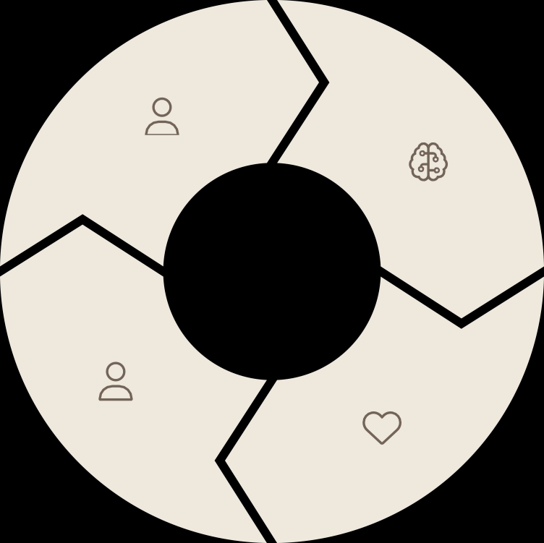
Early to Late Adulthood
Physical Changes
Peak strength in early adulthood; gradual decline with age (Loid et al.,
2024).
Cognitive Function
Mastery in decision-making; slower processing in middle age (Trigueros et al., 2025).
Social Roles
Life role transformations in family, career, and retirement (Pérez-Cano et
al., 2024).
Emotional Regulation
Improved emotional control and focus on significant relationships (Bogin, 2020).

Slide 7

Developmental Milestones
Adolescence
Identity development and abstract thinking (Huang, 2024).
School Age
Reading, writing, and developing peer relationships.
Preschool
Hopping, drawing shapes, and forming sentences.
Infancy
Smiling, babbling, and speaking first words (Loid et al., 2024).

Slide 8


Impact of Early Development
Early Physical Health
Impacts future academic performance and social skills (Burri, 2024).
Emotional Foundations
Predicts future relational skills and resilience.
Cognitive Stimulation
Shapes learning capacity and problem-solving abilities.
Social Experiences
Forms the basis for future interpersonal relationships.

Slide 9


Intervention for Developmental Delays
Optimal Development
Reaching full potential across all domains
Therapeutic Support
Targeted interventions for specific needs
Early Recognition
Identifying delays promptly
Early recognition of developmental delays enables targeted educational programs and therapeutic support. These interventions can significantly improve outcomes across all developmental domains.

Slide 10

Life Factors, Ageing, and Transitions: A Developmental Journey

Slide 11
Genetic Inheritance: The Blueprint
Physical Traits
Determines appearance and disease risks.
Developmental Limits
Sets maximum potential for growth.
Psychological Traits
Influences intellectual and emotional development.

Slide 12



Socioeconomic Status: Resource Pathways
Education
Academic achievement gaps
Healthcare
Access to medical services
Nutrition
Quality food availability
Lower SES backgrounds often face developmental delays and chronic health issues. Persistent stress from poverty can lead to mental health conditions.

Slide 13





Major Life Events: Disrupting the Path
Long-term Illness
Alters bodily processes and development.
Migration
Disrupts cognitive growth patterns.
Family Breakdown
Influences emotional development.
Social Isolation
Shapes social development trajectories.

Slide 14

Physical Changes of Ageing: Musculoskeletal System
Sarcopenia
Muscle mass and strength decline. Leads to poor mobility and higher fracture risk.
Osteoporosis
Bone density loss, especially in postmenopausal women.
Increases fracture susceptibility.
Osteoarthritis
Joint cartilage degeneration. Causes movement restrictions and pain, affecting daily routines.

Slide 15

Respiratory System Changes in Ageing
Decreased Lung Compliance
Reduced elasticity affects breathing
efficiency
Reduced Vital Capacity
Lower maximum air volume exchange
Thoracic Cage Changes
Structural alterations worsen function
Oxygen Exchange Decline
Less efficient gas transfer in lungs

Slide 16
Psychological Changes in Ageing
Cognitive Function
Processing speed slows down Executive abilities decrease Multitasking becomes challenging
Crystallized Intelligence
Accumulated knowledge remains stable
May continue to improve with age Helps compensate for other declines
Self-Esteem
Affected by social role changes
Positive social experiences help maintain it
Family dynamics play crucial role

Slide 17



Lifestyle Interventions for Healthy Ageing
Regular Exercise
Improves physical self-awareness and maintains muscle mass. Enhances mobility and reduces fall risk.
Mental Activities
Reading and puzzles protect cognitive function. Helps maintain neural connections and processing speed.
Social Interaction
Regular social engagement boosts mood and cognition. Prevents isolation and maintains self-esteem.

Slide 18

Key Life Transitions
Education Start
Children entering structured educational settings begin academic and social growth. Shapes future learning patterns and social skills.
Career Changes
Employment transitions impact personal identity and financial independence. Include new jobs, promotions, and unemployment risks.
Retirement
Major life change involving transformation of routine activities and personal identity. Requires significant psychological adjustment.

Slide 19

Person-Centered Support Through Transitions
Educational Support
School counselors aid transitions with tailored learning plans.
Career Guidance
Advisors assist with job changes through counseling and skill development.
Retirement Planning
Geriatric specialists help seniors adapt with personalized plans.
Effective support recognizes individual needs, preferences, and values. This empowers people through transitions and improves outcomes.

